Slide 1
Welcome
Education Compact Team Meeting
March 20, 2018

Slide 2
Introductions

Slide 3
Richmond’s Education Compact
Purpose and structure

Slide 4
Richmond’s Education Compact
Collaboration Structure
Ed Compact Team:
Explore current needs, best and promising practices, strategies, policies and proposals for supporting the whole child
Provide non-binding advisory input to council, the mayor, or the school board
12 Citizens
3 School Board
3 City Council
Mayor’s Designees
Superintendent’s Designees
Council
School Board
Mayor
Mayor’s Office
Human Services
Library
Social Services
Parks & Rec
OCWB
Supt’s Office
RPS Finance
RPS Academic Officer
RPS Family & Cmmty Engagement
RPS Operations
Children’s Cabinet:
Identify opportunities for collaboration
Align support services and facilitate effective implementation
Quarterly Meetings:
Communication and information-sharing on issues for our children and youth to build shared understanding of the needs and strategies for addressing them

Slide 5
A Whole Child Approach
National, State, and Local Efforts
Considerations for Getting a New Group Started

Slide 6
Changing the Odds for Youth by Changing the Way Leaders Do Business.
The Readiness Target

Slide 7
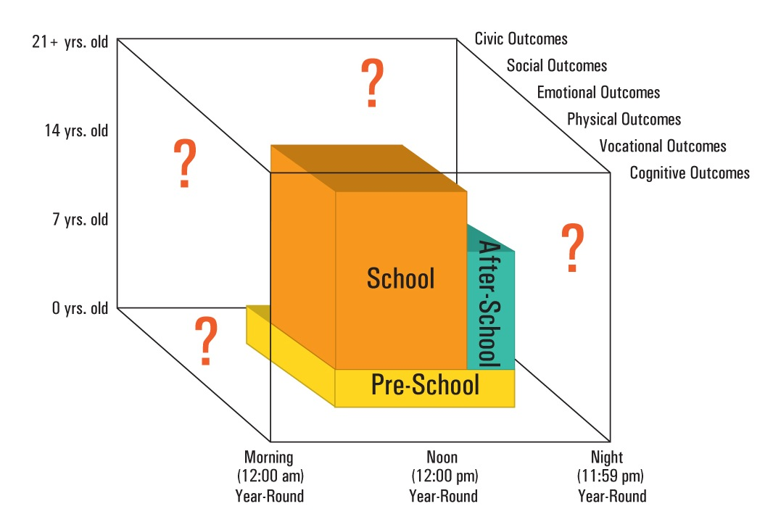
Where does development occur?
At its best, school only fills
a portion of developmental space

Slide 8
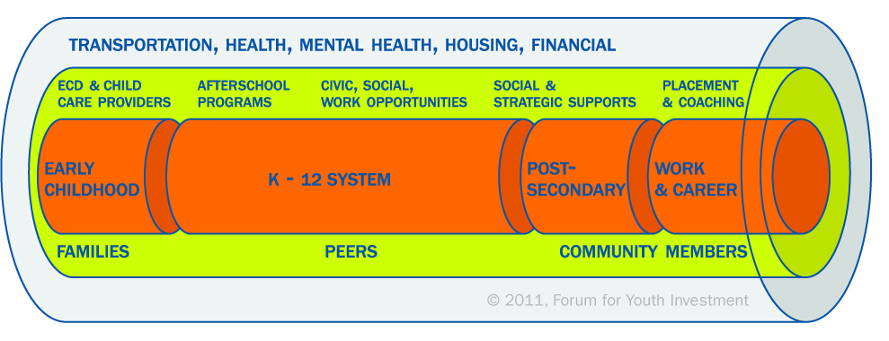
The Insulated Pipeline:
Cradle to Career Investments. Who is Responsible?
“Cradle to career” insulation (0-24)

Slide 9






Focusing on the small gear challenging leaders to think differently & act differently…
Developmentally On Track: Productive
Connected
Healthy & Safe
People
Data
Money
Coordinated
Accessible
Well-Attended High Quality

Slide 10
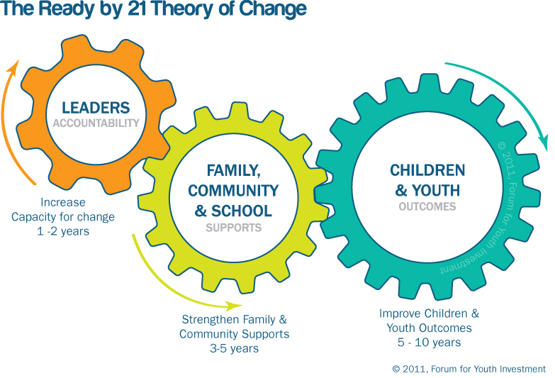
Moving the small gear makes a BIG difference

Slide 11
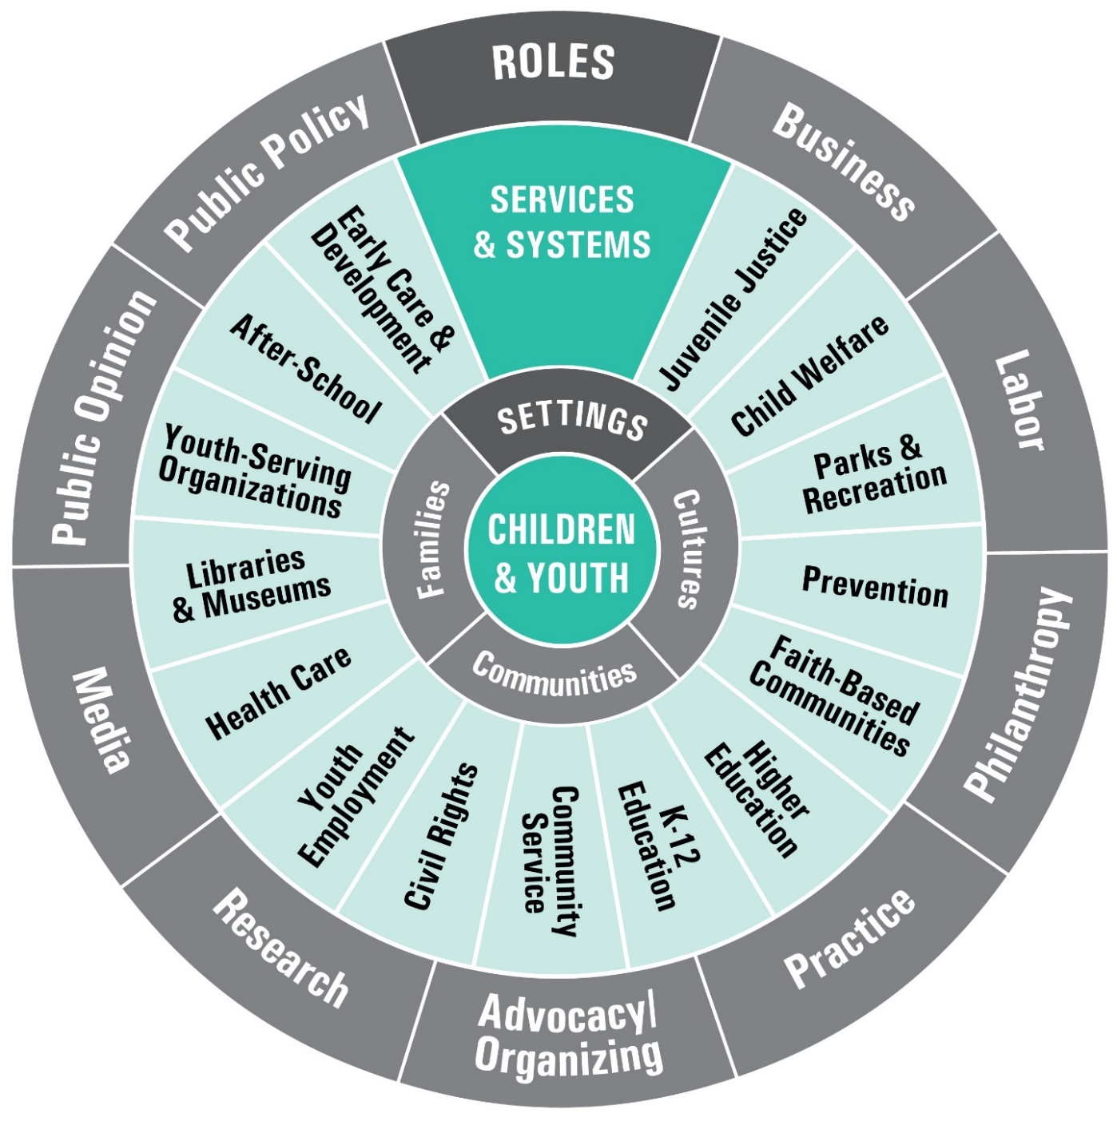
Which role are you in?
Which Service/System are you most familiar with?
Where do you hope to learn from your peers?

Slide 12
Examples
Children’s Cabinet Models

Slide 13
What do Children’s Cabinets do?
Governors, County Executives/ Commissioners, and Mayors increasingly establishing them by Executive order or Ordinance
They work to:
  coordinate policies and systems
  align and generate resources
  commit to common outcomes
  share data across agencies
  engage community stakeholders
…with the goal of improving the well-being of young people

Slide 14
Essentially they focus on alignment of ….
People
Data
Money

Slide 15
Minneapolis
Somerville
Salem
Newton
Providence
New York City
San Francisco
Newark
Oakland
Fairfax County
Richmond
Broward County
Santa Fe
Louisville
Denver
New Orleans

Slide 16
Executive Order No. 139
Establishes the Denver Children’s Cabinet as the policy making group to coordinate city-based programs and services in order to create opportunities for Denver’s children and youth to succeed.
  Improve communication between agencies
  Coordinate and align programs and services
  Develop strategies to address gaps and remove barriers that hinder opportunities for Denver children and youth

Slide 17
Structure of Coordinating Body
CHAIR: Executive Director of Children’s Affairs
Manager of the Department of Human Services
Manager of Parks and Recreation
Manager of Safety
Chief of Police
Director of Corrections and Undersheriff
Manager of Finance
Manager of Environmental Health
Director of the Office of Economic Development
Director of Peak Performance
Director of the Office of Strategic Partnerships
Manager of Community Planning and Development
Director of Development Services
Director of Denver’s Road home
Director of Career Service Authority
City Council Member
City Librarian
Director of Denver Housing Authority
Director of Community Health Services, Denver Health and Hospital Authority
Management representative of Denver Public Schools
Management representative of the Denver Preschool Program
A board member of the Scientific and Cultural Facilities District

Slide 18

Denver Mayor Hancock’s Goals For Children

Slide 19
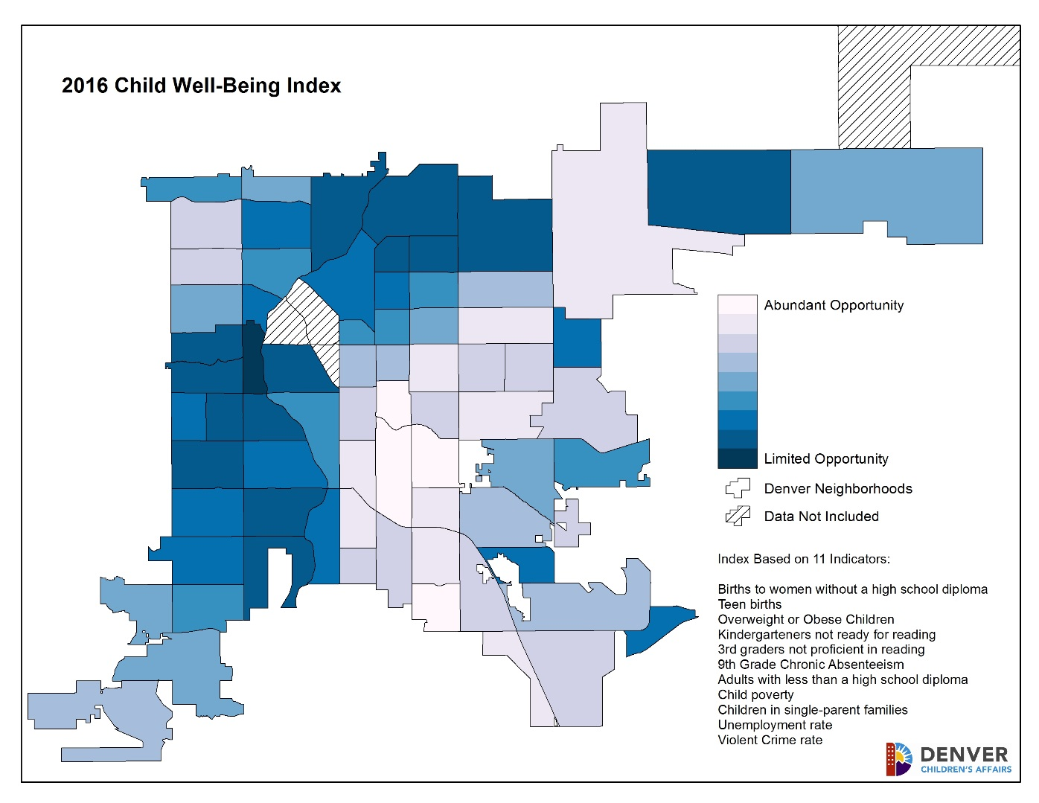

Slide 20
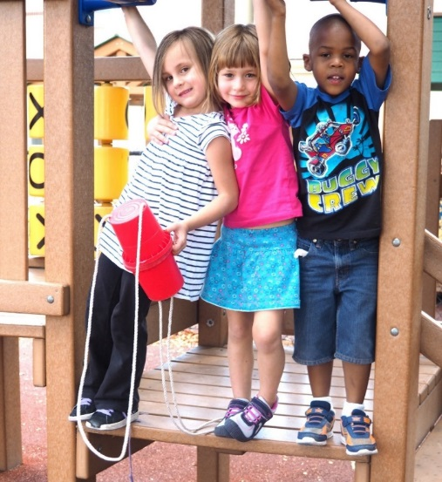
Fiscal Resource Map
This fiscal resource map is a data-driven analysis intended to empower the Children’s Cabinet members with essential information they need to make informed decisions regarding investments and understand critical gaps and opportunities in programs and services for children in Denver.
A fiscal resource map fulfills several objectives identified in the Executive Order:
Create and maintain an updated inventory of programs and services offered for children and youth, and quantify the City’s investment in these programs
Identify areas where coordination will lead to better services and move opportunities and implement improvements
Identify improvement opportunities within City services and implement plans to address them

Slide 21
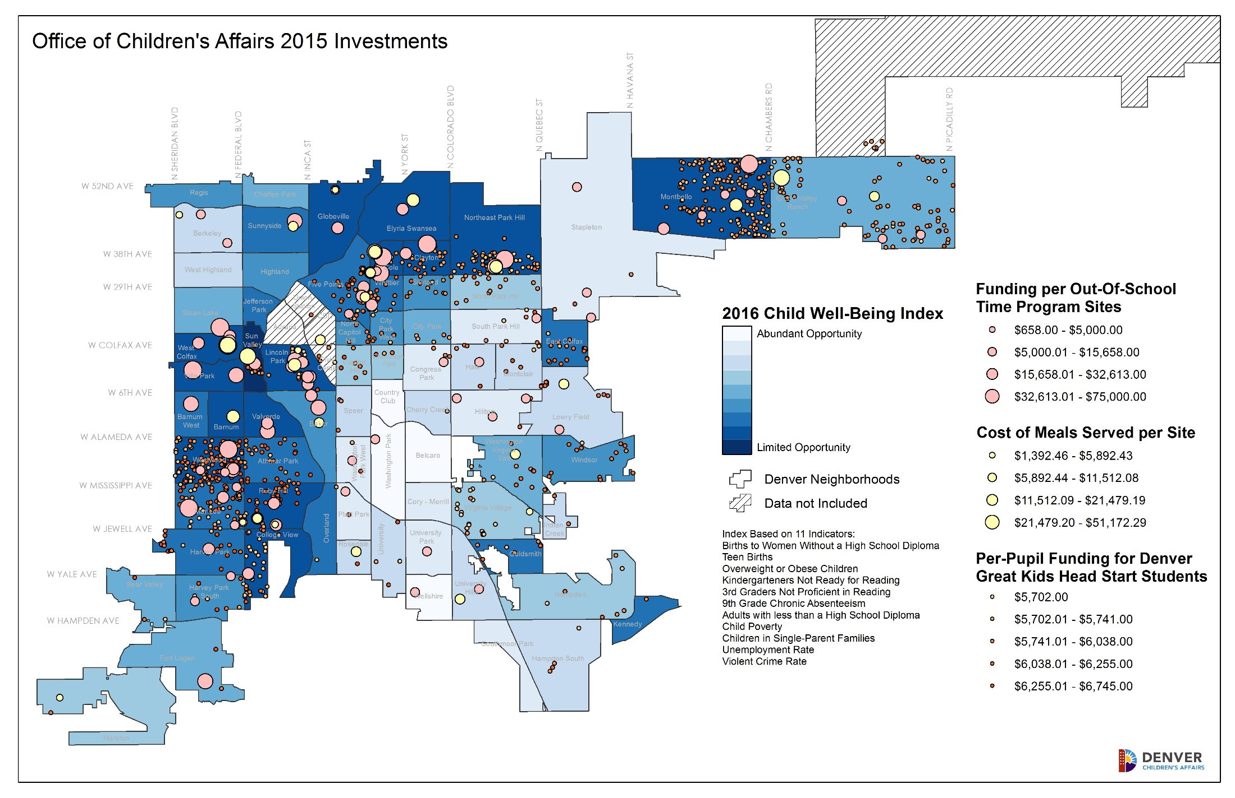

Slide 22

Why the Successful Children and Youth Policy Team (SCYPT) in Fairfax County, VA was formed:
There was a need for…
  …coordinated approaches to issues.
  …policy-focused development of initiatives.
  …in-depth vetting of budget and policy proposals.
  …multi-sector and multi-system engagement in planning and implementation.

Slide 23

SCYPT Members
County Members
Jeff McKay, Board of Supervisors
Cathy Hudgins, Board of Supervisors
Pat Harrison, Deputy County Executive
Dave Rohrer, Deputy County Executive
Gloria Addo-Ayensu, Department of Health
Bob Bermingham, Juvenile & Domestic Relations Dist. Court
Nannette Bowler, Department of Family Services
Tisha Deeghan, Community Services Board
Chris Leonard, Neighborhood and Community Services
Ed Roessler, Police Department
School Members
Megan McLaughlin, School Board
Tamara Derenak Kaufax, School Board
Steven Lockard, Deputy Superintendent
Francisco Duran, Chief Academic Officer
Jane Lipp, Special Services
Jeffrey Platenberg, Facilities and Transportation Services
Douglas Tyson, Region 1
Mary Ann Panarelli, Intervention and Prevention Services
Ipsa Stringer, Bailey’s Elementary School
Community Members
Jack Dobbyn, Human Services Council
George Becerra, FCPS Minority Student Achievement Oversight Committee
Fahemeh Pirzadeh, Reston Children’s Center
Darrell White, Bethlehem Baptist Church
Kelly Henderson, Community Policy & Management Team
Rick Leichtweis, Inova Health System
Judith Dittman, Alternative House
Eileen Ellsworth, Community Foundation for Northern Virginia
Dana Kauffman, Northern Virginia Community College
Mark Ginsberg, George Mason University
Karen Cleveland, Leadership Fairfax
Vacant, Fairfax County Council of PTAs
Vacant, Head Start Policy Council

Slide 24
SCYPT’s Vision and Mission
Vision: A community where all children and youth thrive and reach their full potential.
SCYPT Mission: The Successful Children and Youth Policy Team provides policy and resource guidance and champions the collective efforts of the Fairfax community to ensure all children, youth, and their families and communities have equitable access to quality services, supports, and opportunities to further their success and well-being.

Slide 25

Shared Community Level Outcomes

Slide 26
Ensuring Adequate Resources
Backbone Organization (NCS Prevention Unit)
Mechanisms for reporting back to, and requesting funding/policy action of, the Board of Supervisors and School Board
The Partners in Prevention Fund

Slide 27

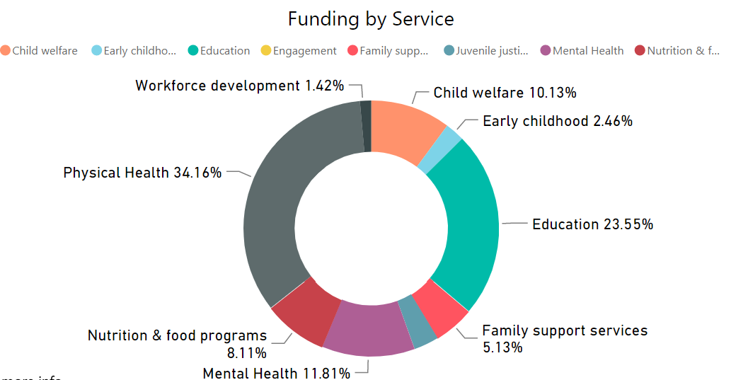
Virginia Children’s Fiscal Map link

Slide 28
Administrative and Operating Decisions
How will decisions be made? | Consensus decision making Majority decision making Robert’s rules of order
How will meetings be structured? | Closed Open Rotate between closed and open
How will a timeline for meetings be developed? | Set regular times or on a meeting by meeting basis Amount of time per meeting
Must there be a certain quorum in attendance for decisions to be made? | Yes, more than 2/3 present Yes, more than half No, decisions must continue with those that are present
Will designees be allowed? | Yes or no Must be consistent designees or can change Does or doesn’t have decision making power
Will there be work groups? | Temporarily approve work areas Formally establish work areas Do you need chairs of work groups and will you allow other stakeholders to join?
Will you have chairs, co-chairs, vice chairs? | Based on individual or position Time limited/rotating or permanent Staff will call meeting to order
Who will provide staffing?
Who will facilitate meetings?

Slide 29

Start on time/end on time
Everyone’s input is important, so pay attention to how often you speak
Listen with an open mind, and for commonalities
Keep your commitments/ follow up and follow through
Balance the need for thorough input with the need to move forward
Don’t just disagree, offer a doable alternative idea
Speak to the point on the floor
Define terms and acronyms
Think broadly, not just about ‘your issue’
Support your position with data

Slide 30
  Sample Roles for members:
Consider the full landscape of policies, systems and data about children and youth
Serve as a visible champion on children and youth issues within the community and within your sector and organization
Model desired changes/policy directions within your organization/sphere of influence
Direct resources (funding, people, advocacy, attention, etc.) to address identified issues within your organization
Provide perspective from your sector and serve as a voice of the sector, able to discuss current trends and efforts
Review and provide data to aid in decision-making

Slide 31
Next Steps

